Slide 1
Cloud project Regis university
Alla Topp
Regis university
Msds 696, spring 2020

Slide 2

Background
All work is done in active services like cobalt, tin0, tin1, tin2 and created virtual machines under root user
Specs for virtual machines: 4 CPU cores, 4/8GB RAM, 40GB hard disk
There is Cloud Project GitHub page where all documentation is posted

Slide 3



Project goals
Representing performance under 2 sets of configuration parameters for VM/server, network by analyzing CPU cores, CPU clock speed and RAM size
Data collection to determine hardware specification on new equipment by performing load testing on VM in Cloud Stack (for lab environment)
Estimate how much RAM a cluster of computers would need to support 2-3 Data Science classes if every student was using it simultaneously
Creating documentation/instruction for future students
to use in Data Science classes and students who will continue
working on the project with minimum learning
Gain professional experience with data science tools
Become comfortable with Linux, SQL and Python

Slide 4










Software

Slide 5
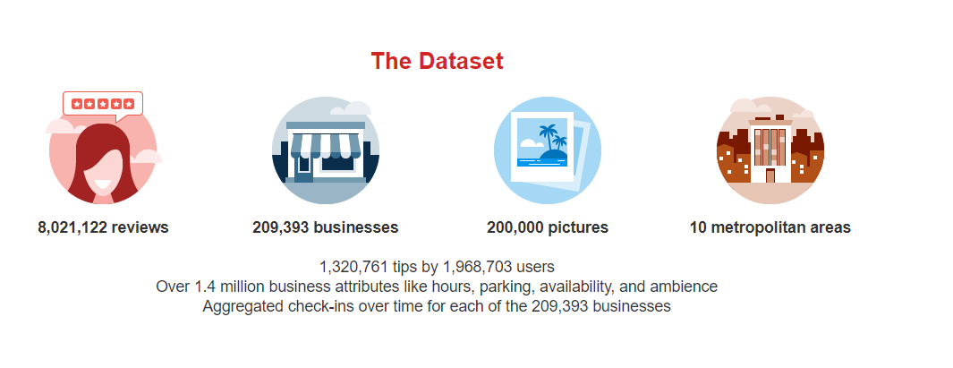
Data description

Slide 6
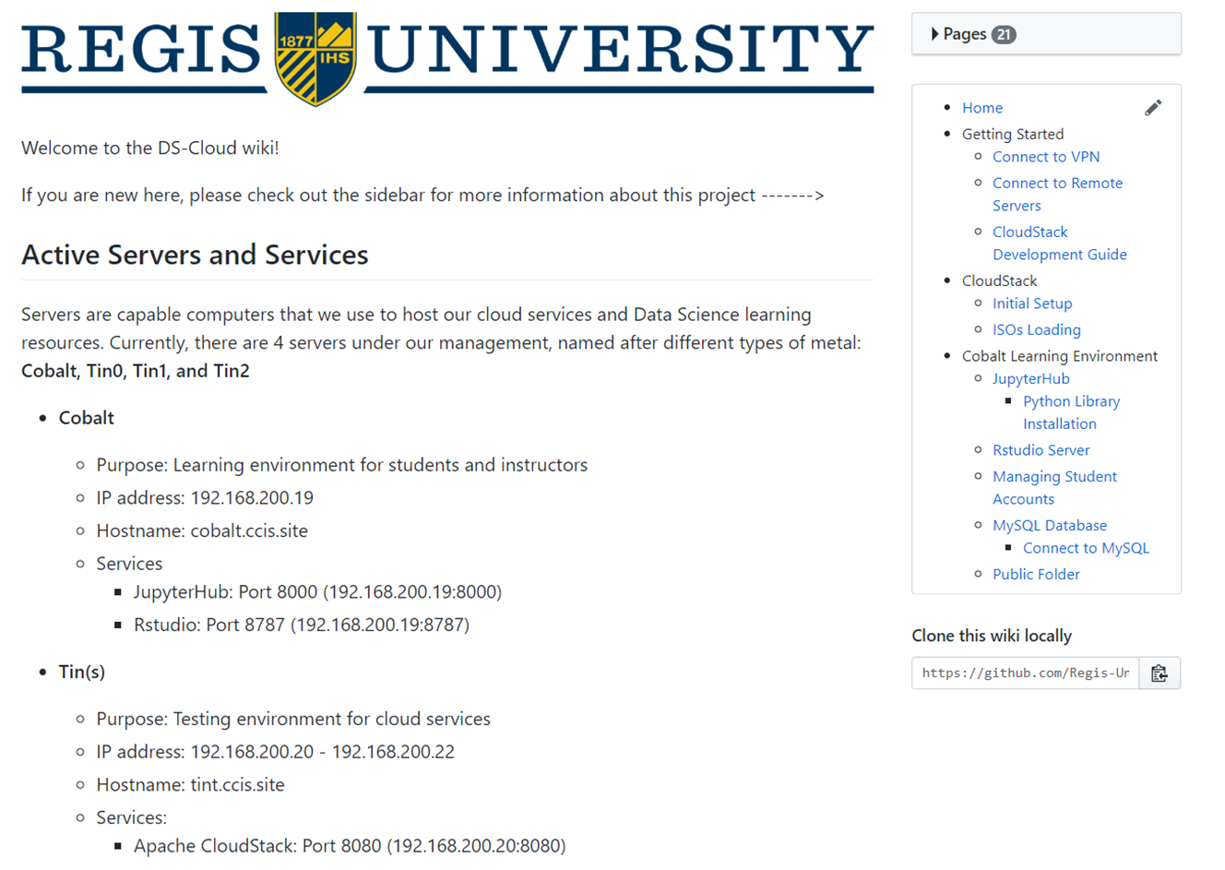
process towards documentation

Slide 7
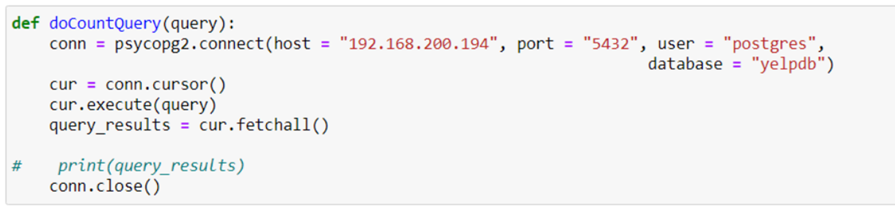
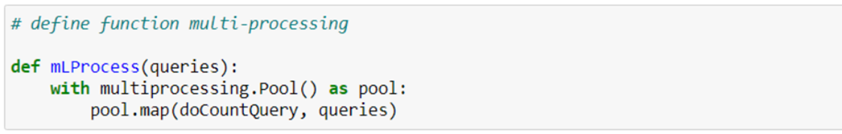
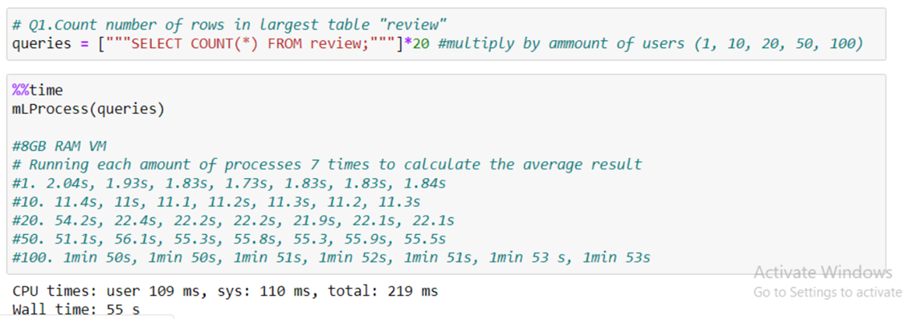
Load testing
Psycopg2 library
Multiprocessing library
%%timeit
5 queries
Each run 7 times for accuracy
Variables: VM IP address, users, queries

Slide 8
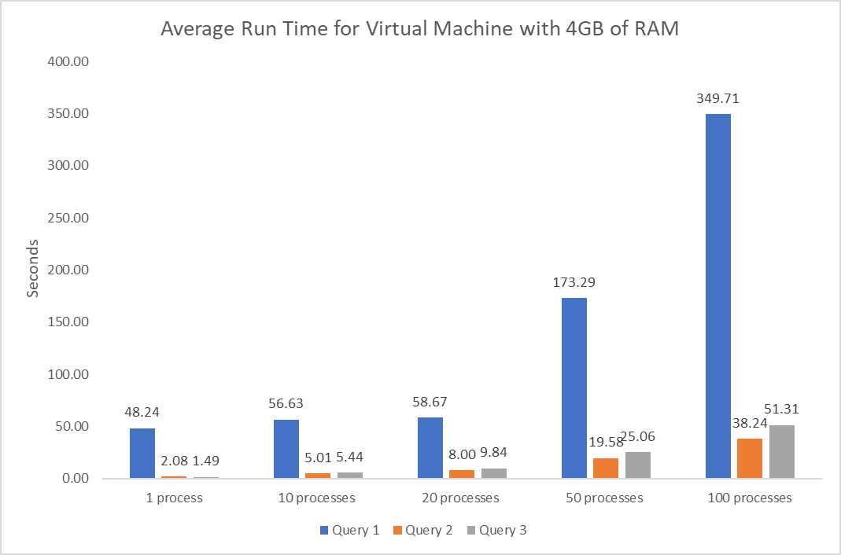

Slide 9
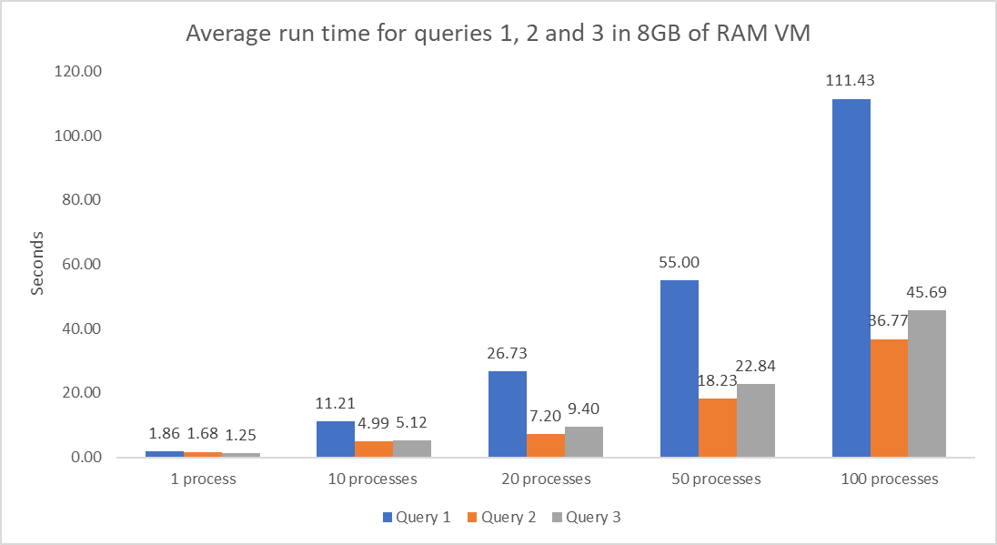

Slide 10
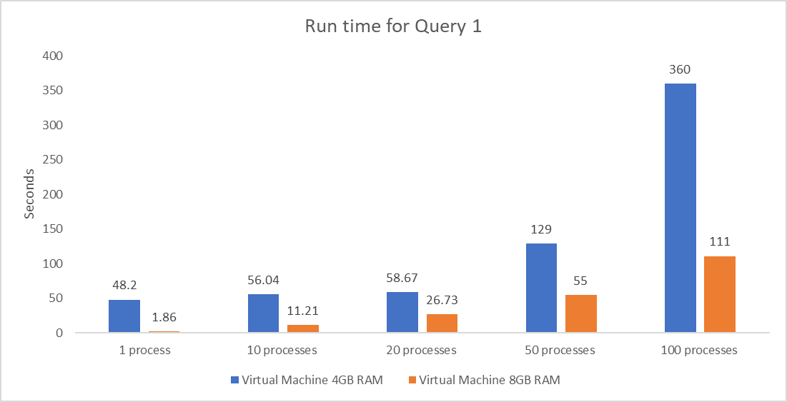
Query 1: Count number of rows in the largest table “Review”

Slide 11
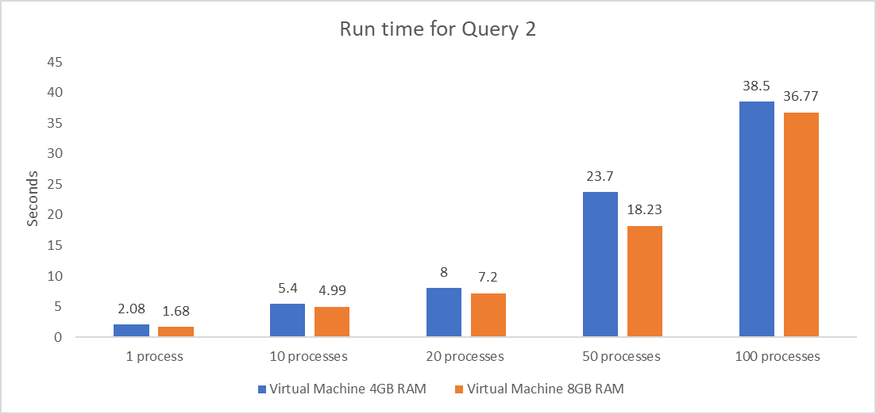
Query 2: Select all distinct names in the user table

Slide 12
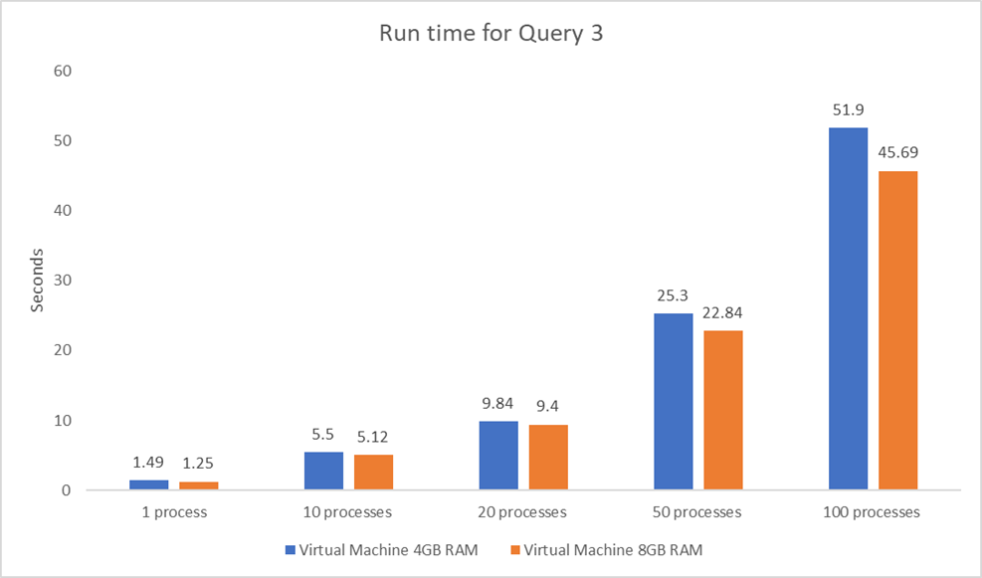
Query 3: Count occurrence of each name in the user table

Slide 13
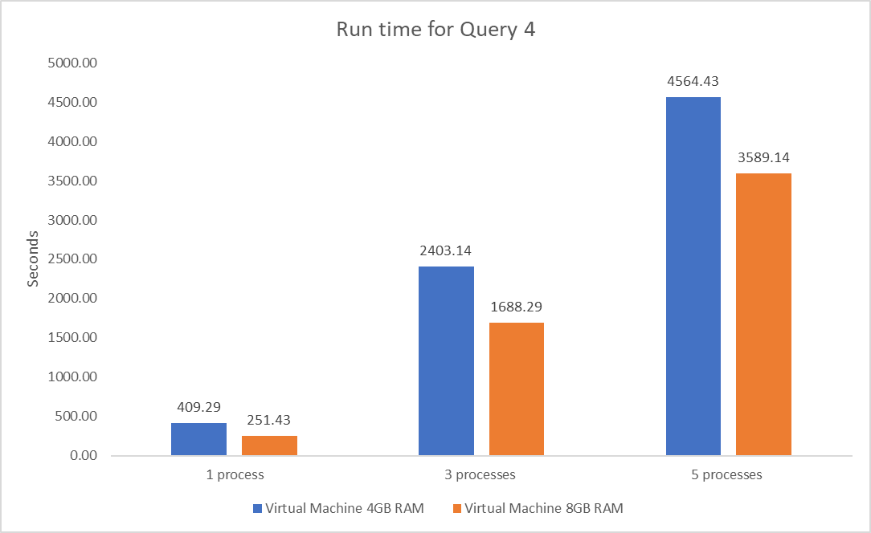
Query 4: Count number of reviews by each user using JOINS

Slide 14
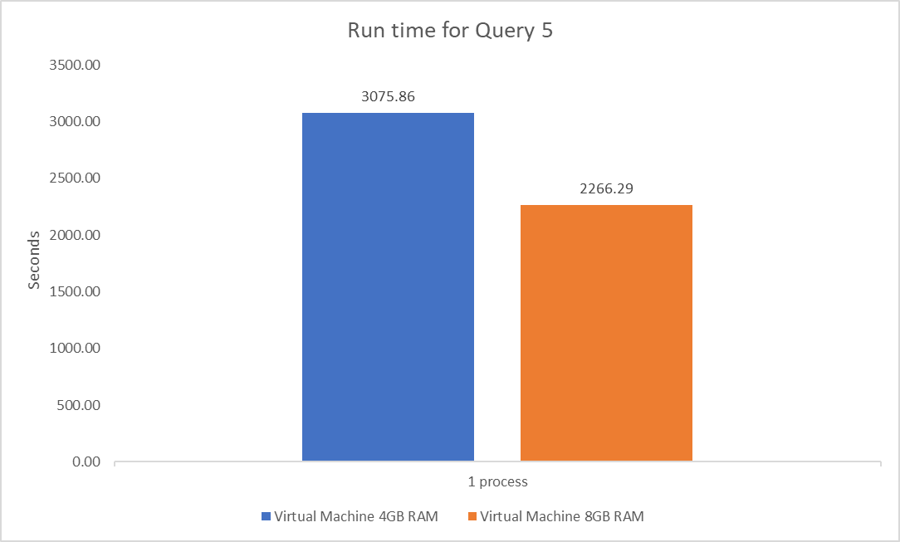
Query 5: Multiple joins including all the tables

Slide 15

findings
Virtual machine with 8GB of RAM showed much better performance overall than virtual machine with 4GB of RAM based on run time
40GB of hard drive on both virtual machines did not allowed to run over 5 processes (users) at the same time because PostgreSQL uses temporary space on hard drive running queries with JOINs
It takes over 100GB of hard drive to run different level queries to test 10, 20, 50 and 100 users working at the same time
VM with 8GB of RAM showed great performance and could be considered to be a standard specs for lab environment

Slide 16

Conclusions
Impossible to have over 10 students (users) or more running queries like 4 and 5 (with joins) at the same time in the VM with such specs because of current server limitations
More memory (RAM) a virtual machine has, better run time will show running large queries
The results of the project allows to make a decision for hardware purchase to create lab environment for the Data Science classes at Regis University
Based on all the processes documented next students in the project will have a starting point to continue next steps with minimum learning

Slide 17

challenges
Coding background limitations (Python, Linux, SSH, SQL)
Configuration/privacy/network problems working with Ubuntu virtual machine and Linux
Yelp data files in a wrong format, difficulties importing files in PostgreSQL
Queries with joins took very long time to run testing 10, 20, 50 processes
A lot of preparation before performing tests with multi-processing

Slide 18
Next steps
Load testing with MongoDB database
Test multi-processing on Virtual Machine with different specifications in Cloud Stack (ex. 16GB RAM, 100 GB hard drive)
Creating machine learning model to predict performance based on the given virtual machine specifications
Making a decision what hardware for lab environment to order

Slide 19
References
https://www.kaggle.com/yelp-dataset/yelp-dataset
https://www.yelp.com/dataset
https://github.com/Regis-University-Data-Science/DS-Cloud

Slide 20


